Slide 1
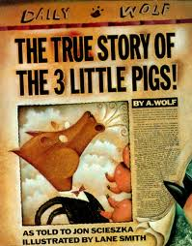
The True Story of the Three Little Pigs

Slide 2
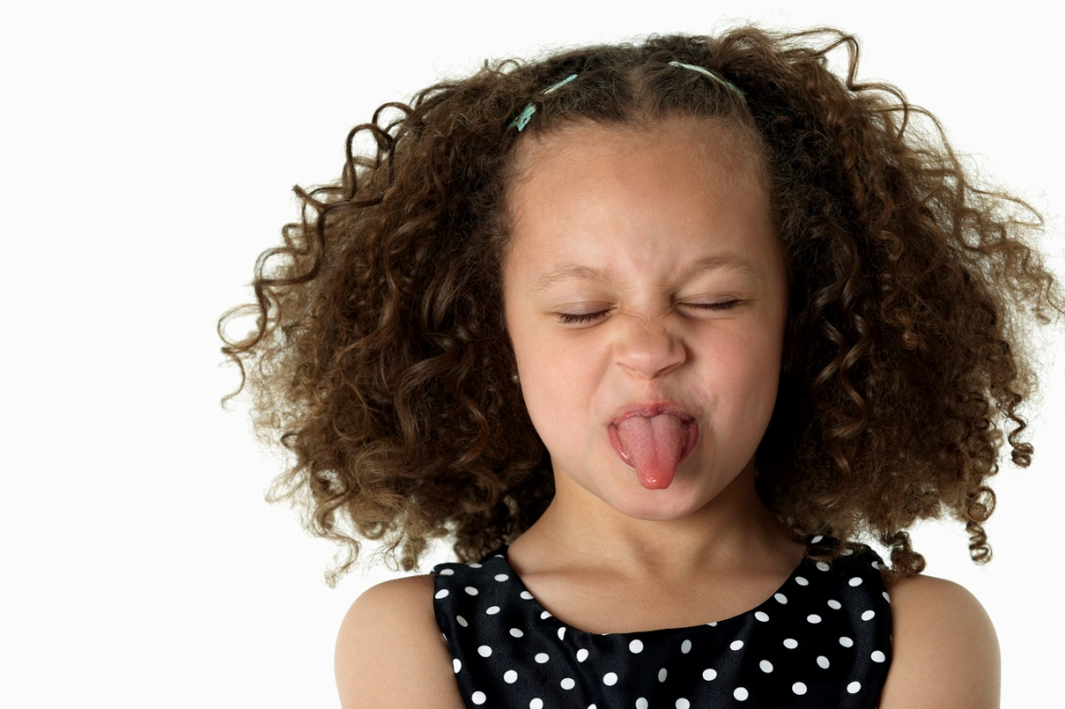
impolite
Impolite – not being nice
  The girl was being impolite when she stuck her tongue out at her mom.

Slide 3
Jazzed
Jazzed – very excited
  The dog was jazzed about his new bone.

Slide 4
Framed
Framed - To make someone appear to be bad or have done something bad.
The innocent man was framed for robbing the bank .

Slide 5

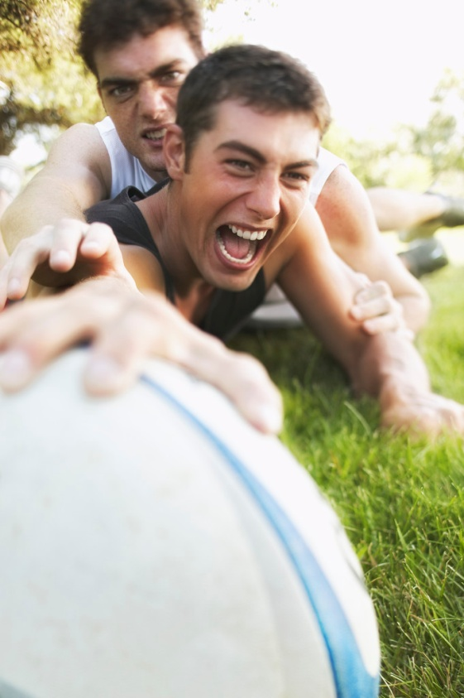
Which one goes with impolite?

Slide 6
Which one goes with jazzed?

Slide 7
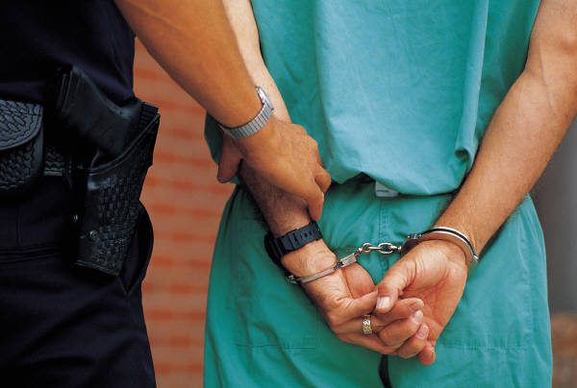
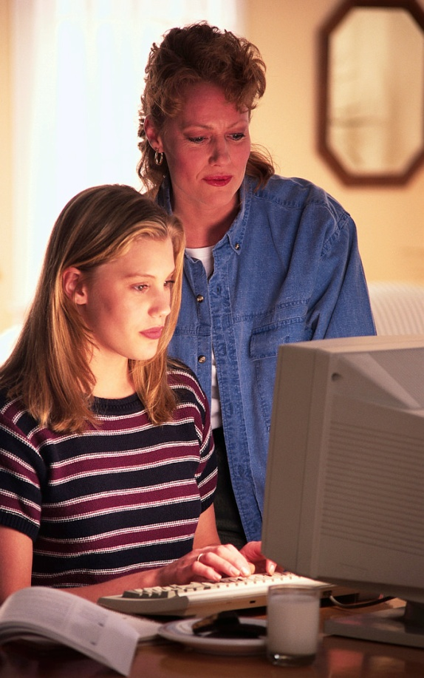
Which one goes with framed?

Slide 8
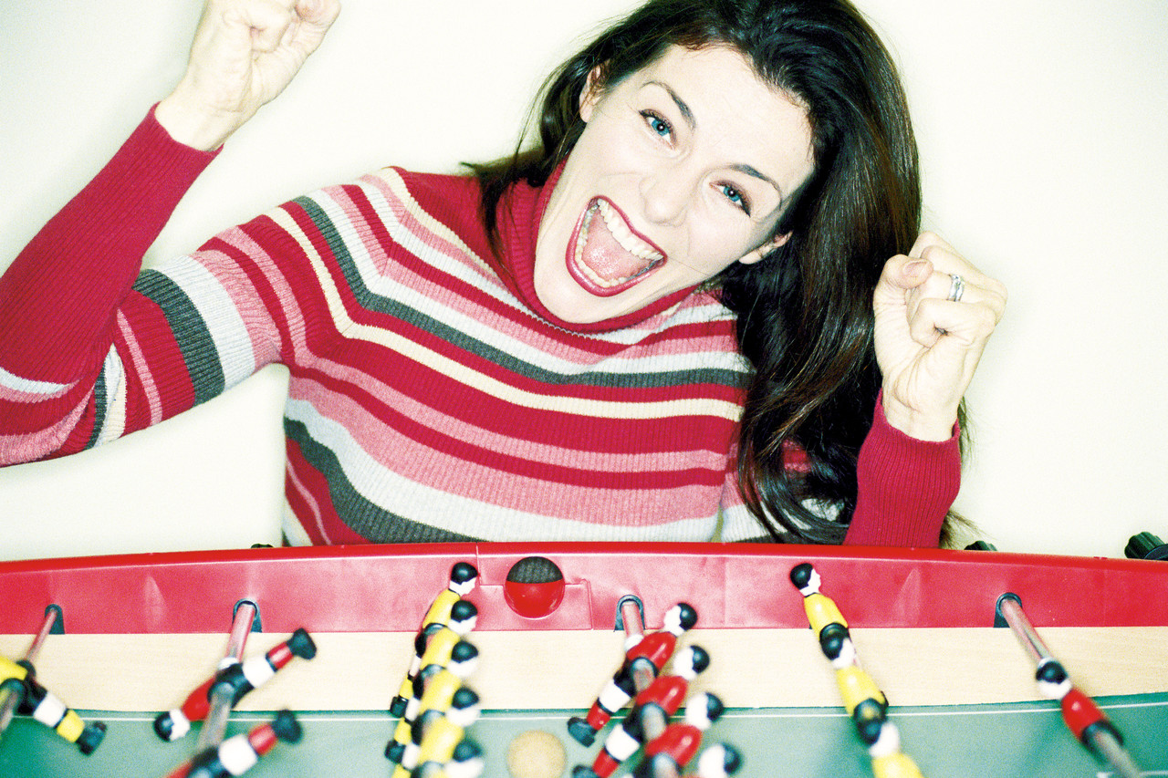
Which word goes with this picture? impolite, jazzed, or framed?

Slide 9
Which word goes with this picture? impolite, jazzed, or framed?

Slide 10
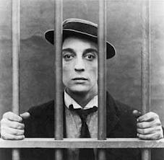
Which word goes with this picture? impolite, jazzed, or framed?

